Slide 1
Matt Mead
Allan Hunt
Emilio Bello

Slide 2






The Big Picture
Retrieve APIs
Convert to DF
Explore Data
Clean Data
Merge DFs
Add Calc Columns
Create DB connection
Create Postgres tables
Populate Tables
Create Database
Create Tables
Populate Tables
Define Primary Keys
Connect to Database
Mirror Tables
Run Flask Server
App Routes to Pages
App Routes to Data
Jsonify Data
Call Data Routes
Store Data in Var
Plot
Populate HTML pages
Set Page Layout
Import JS Files
Import Libraries
Import API Key
Style

Slide 3


https://covidtracking.com/data/api
COVID information
historical by State
Datasets APIs
https://covidtracking.com/data/api
COVID information
historical US Totals
https://datausa.io/about/api/
USA Population
by State

Slide 4
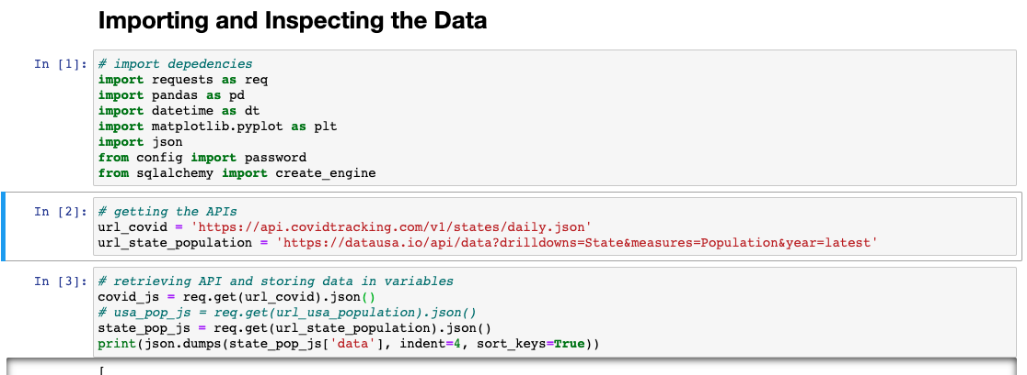
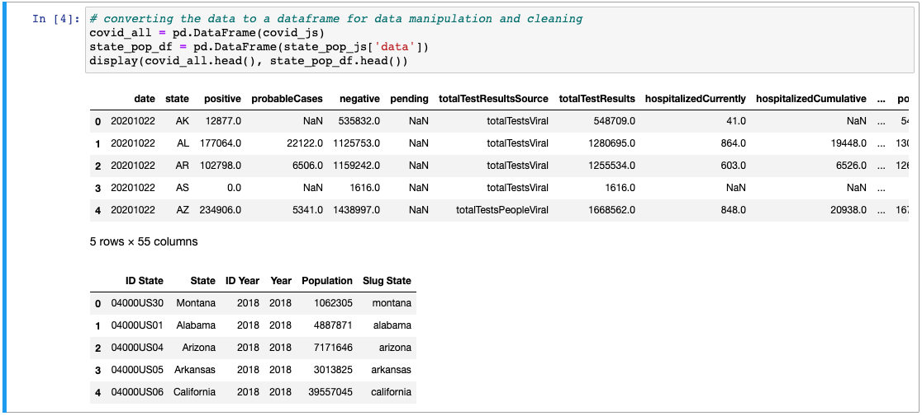
Retrieve APIs
Convert to DF
Explore Data
Clean Data
Merge DFs
Add Calc Columns
Create DB connection
Create Postgres tables
Populate Tables

Slide 5
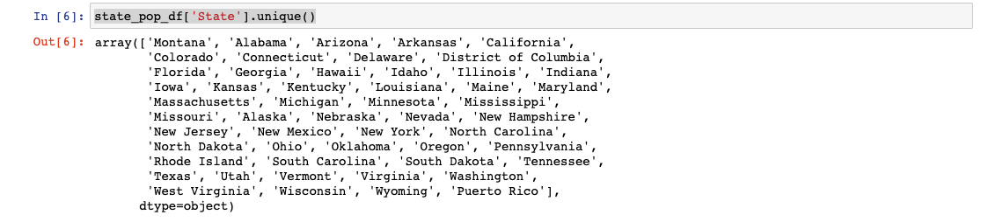
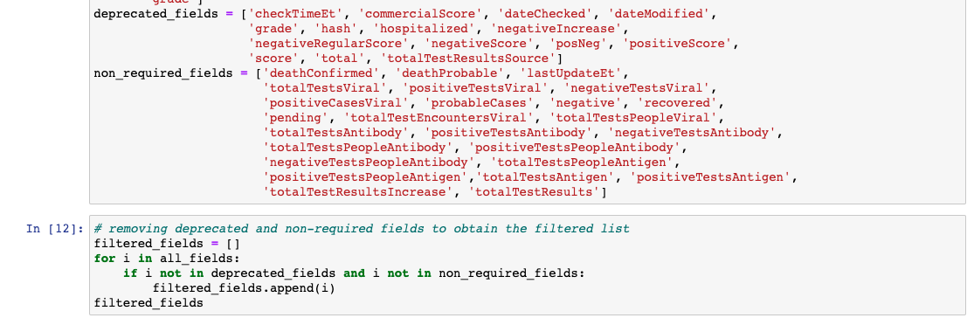
df.head()
df.shape
df.describe()
df.columns
df.info()
Retrieve APIs
Convert to DF
Explore Data
Clean Data
Merge DFs
Add Calc Columns
Create DB connection
Create Postgres tables
Populate Tables

Slide 6
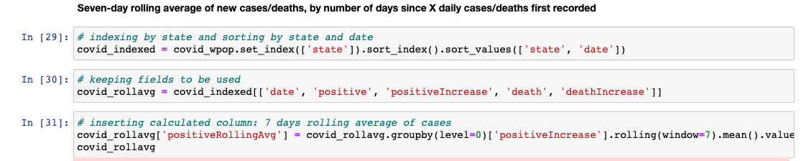
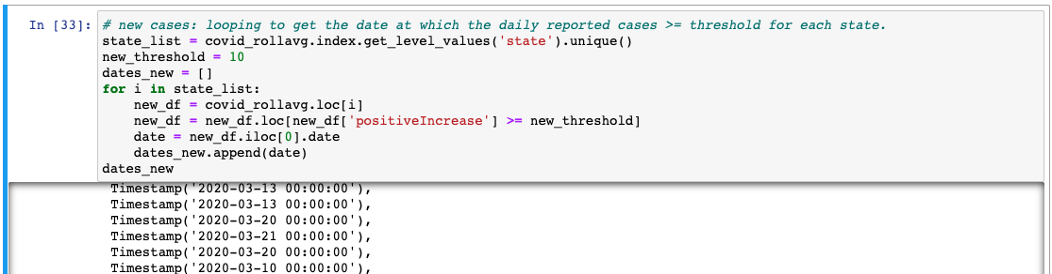
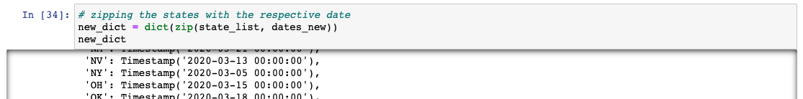
Retrieve APIs
Convert to DF
Explore Data
Clean Data
Merge DFs
Add Calc Columns
Create DB connection
Create Postgres tables
Populate Tables

Slide 7
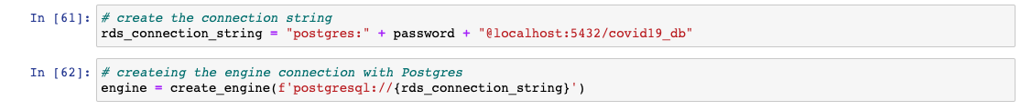
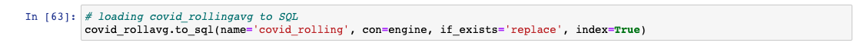
Retrieve APIs
Convert to DF
Explore Data
Clean Data
Merge DFs
Add Calc Columns
Create DB connection
Create Postgres tables
Populate Table

Slide 8
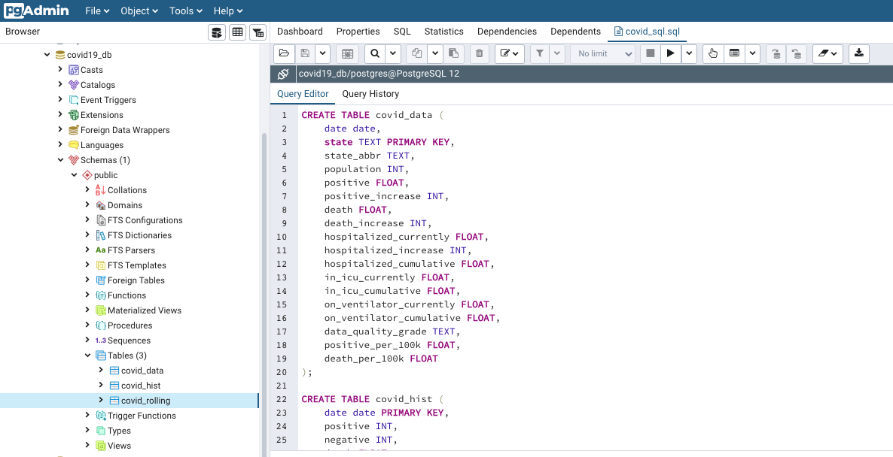
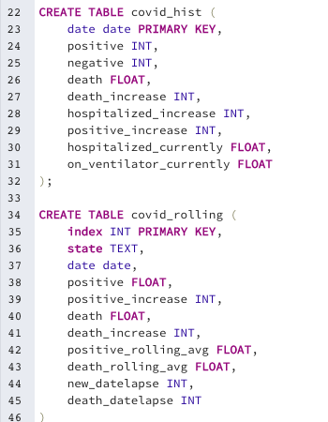
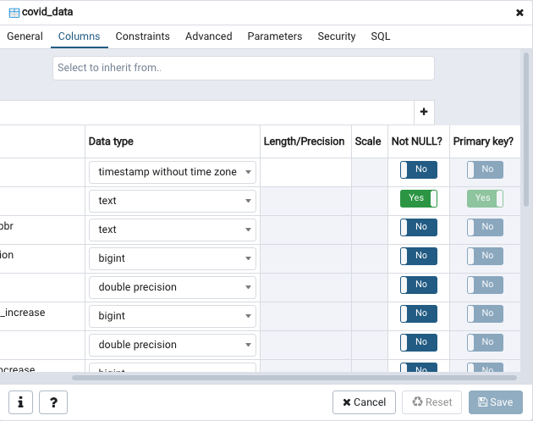
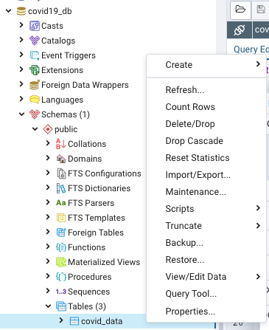
Create Database
Create Tables
Populate Tables
Define Primary Keys

Slide 9
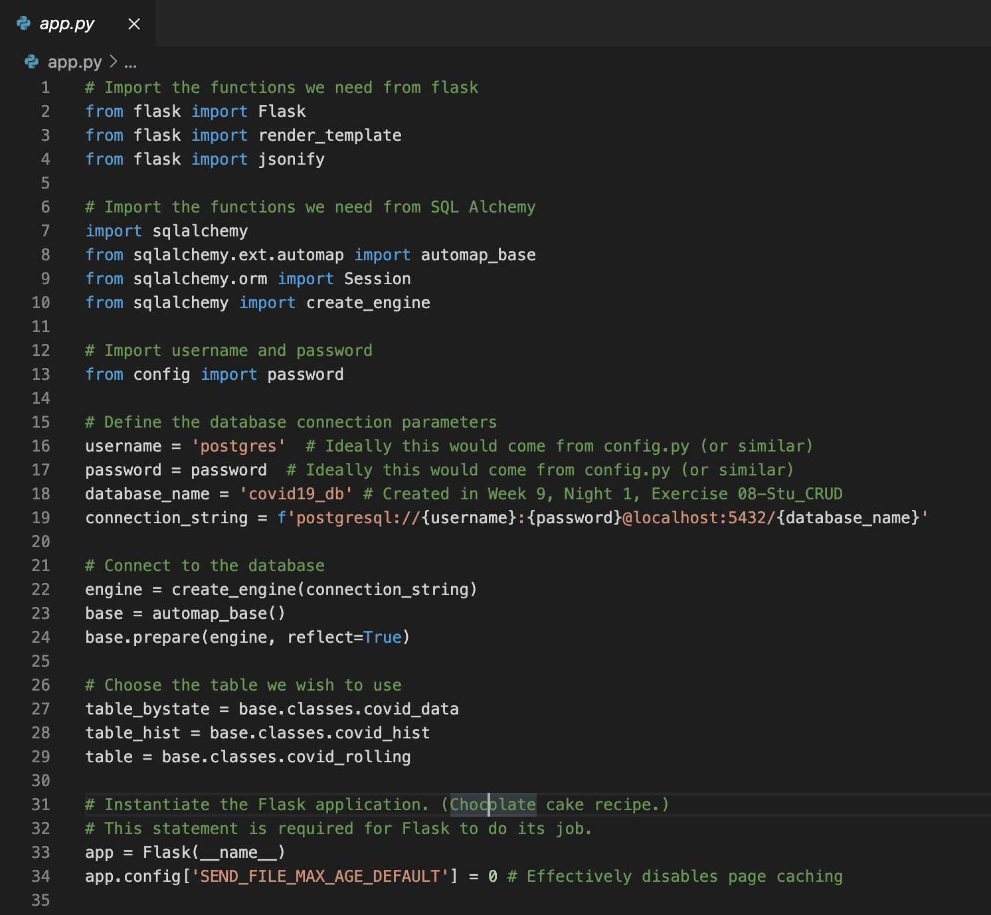

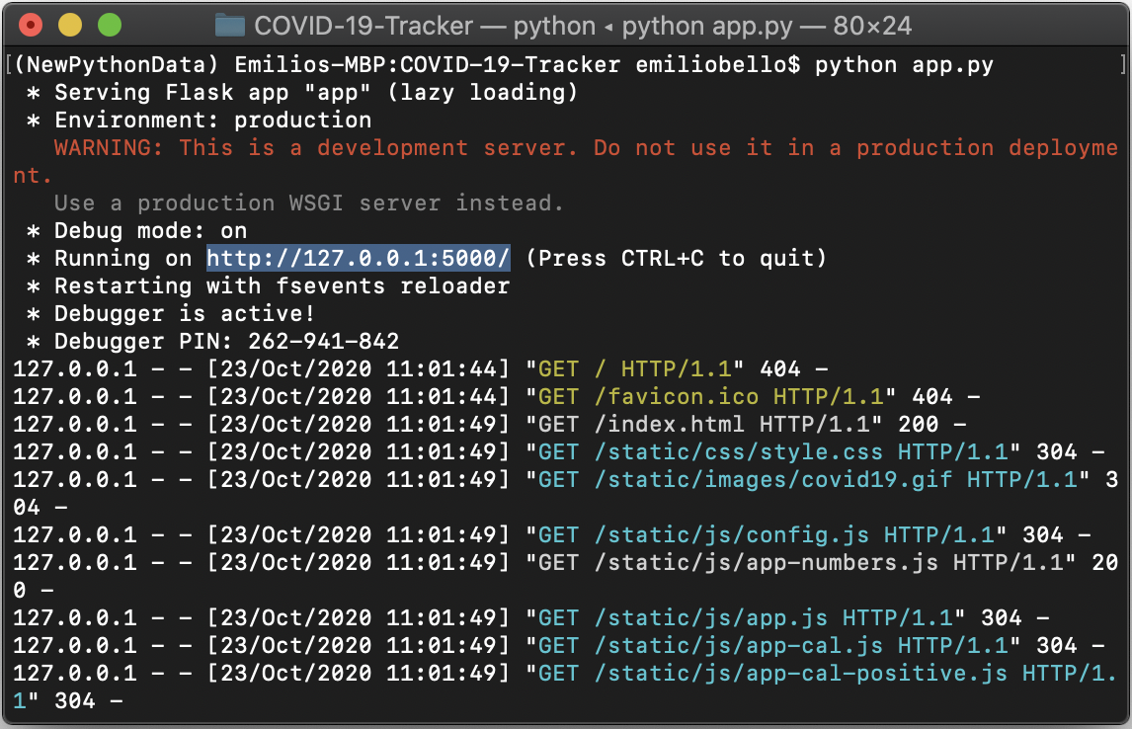
Connect to Database
Mirror Tables
Run Flask Server
App Routes to Pages
App Routes to Data
Jsonify Data

Slide 10
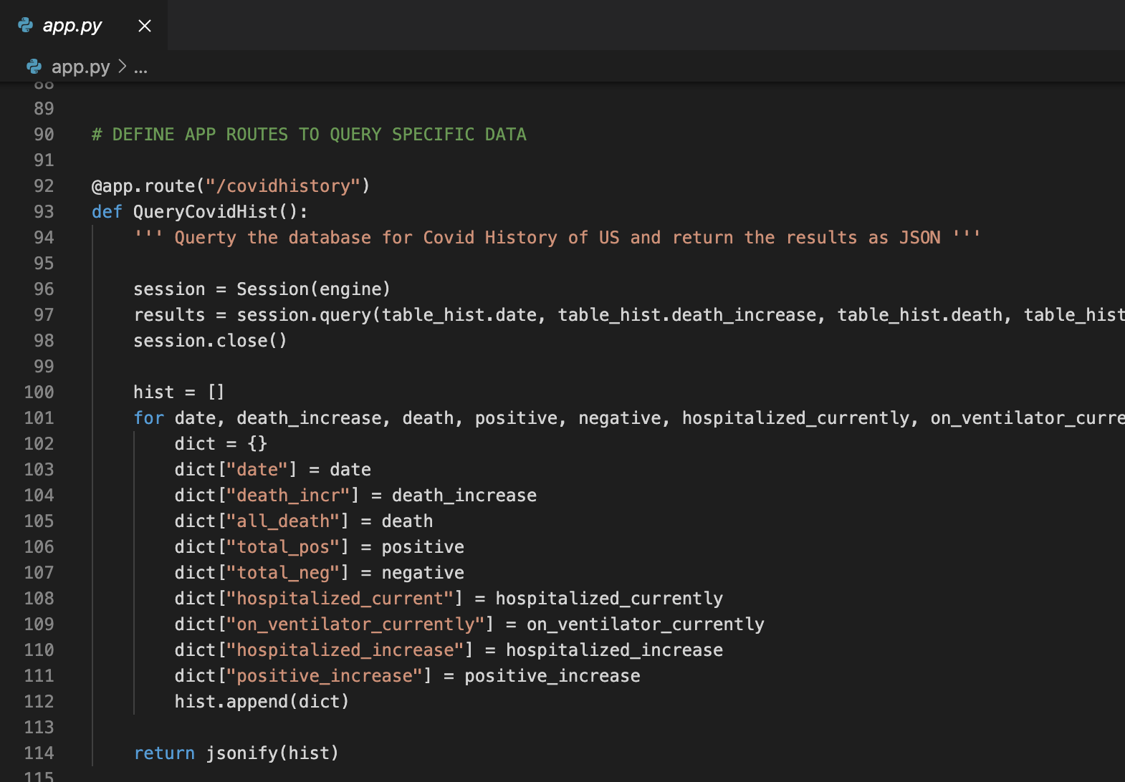

Connect to Database
Mirror Tables
Run Flask Server
App Routes to Pages
App Routes to Data
Jsonify Data

Slide 11
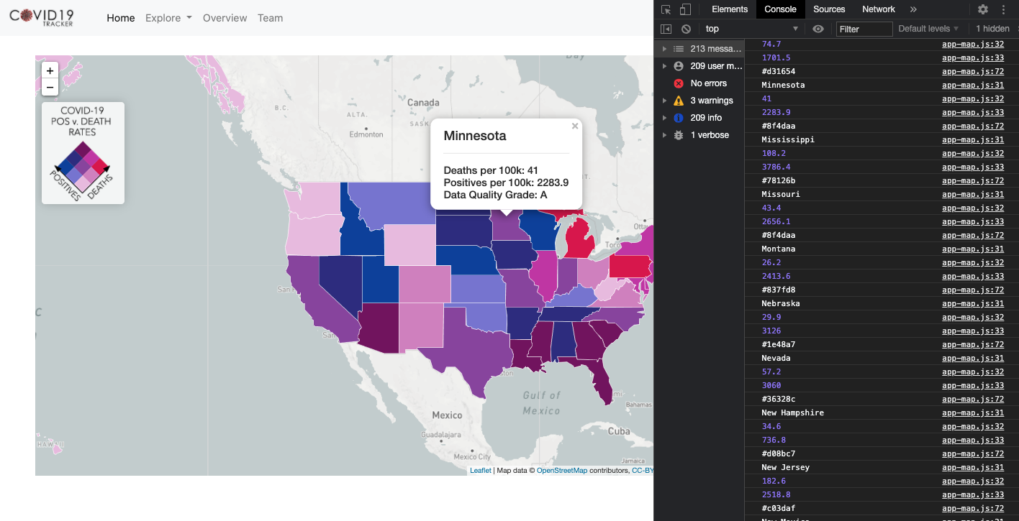

Call Data Routes
Store Data in Var
Plot
Populate HTML pages

Slide 12
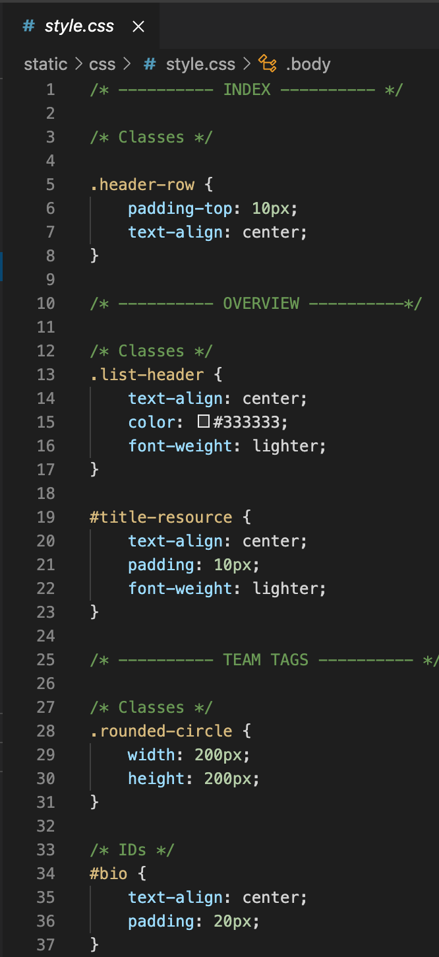
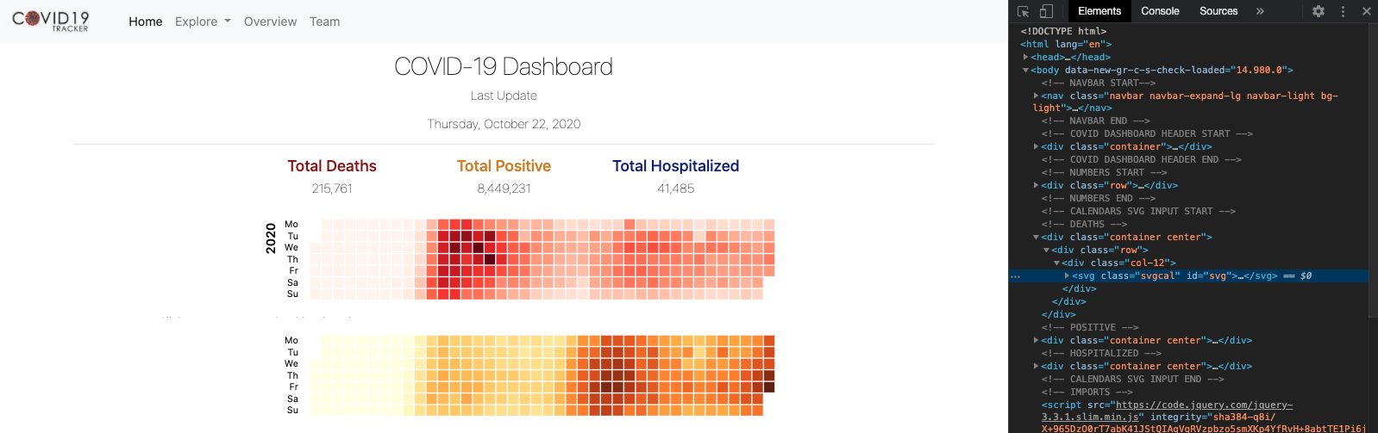

Set Page Layout
Import JS Files
Import Libraries
Import API Key
Style

Slide 13
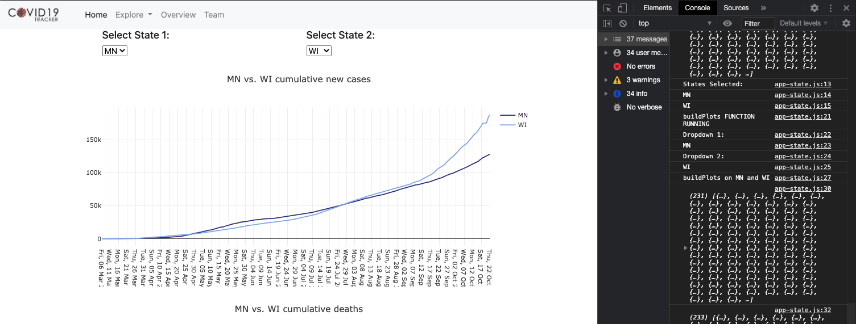

Set Page Layout
Import JS Files
Import Libraries
Import API Key
Style

Slide 14
Final Comments
Data available, which source to select?
Analysis and Calculations
More complex options that derive better insights and stand out from standard line charts and maps

